Slide 1

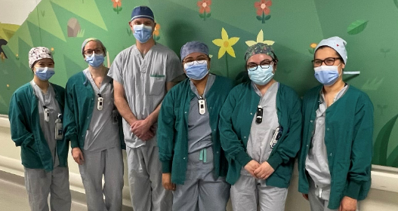
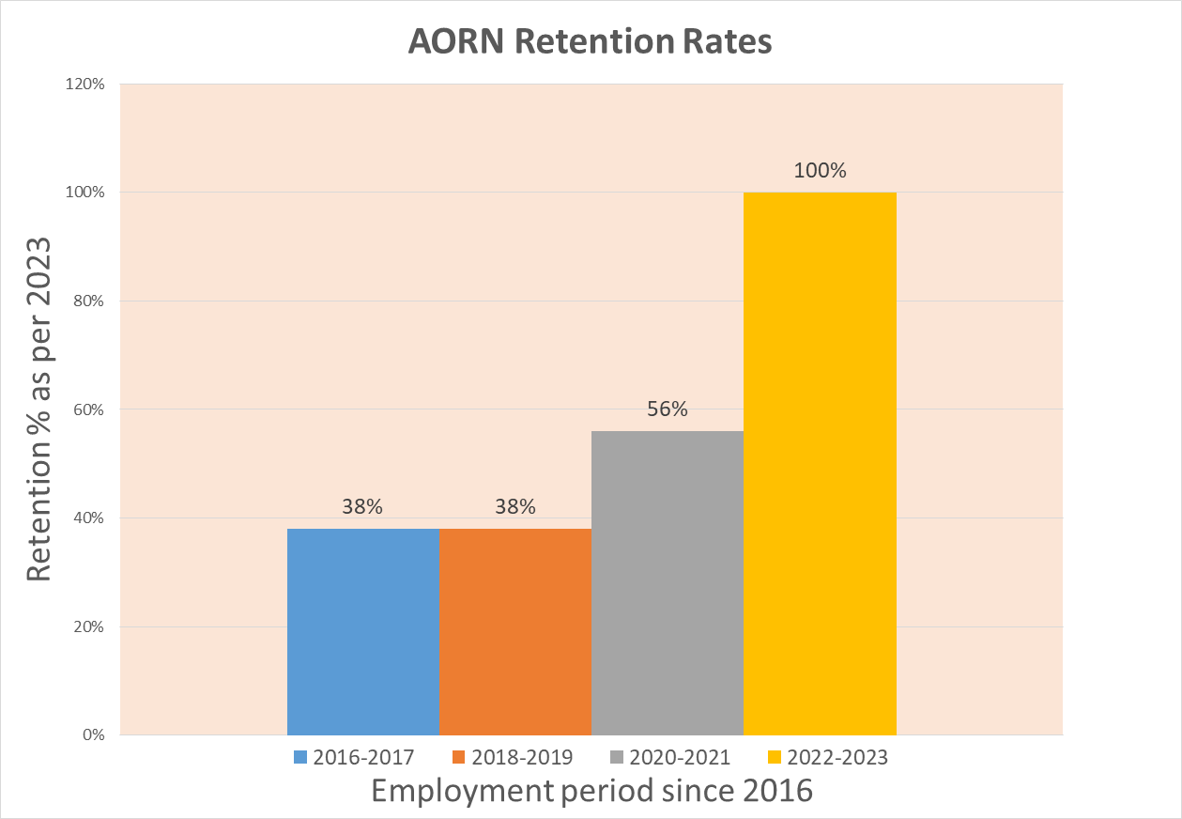

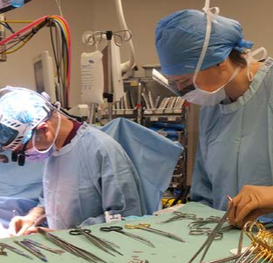
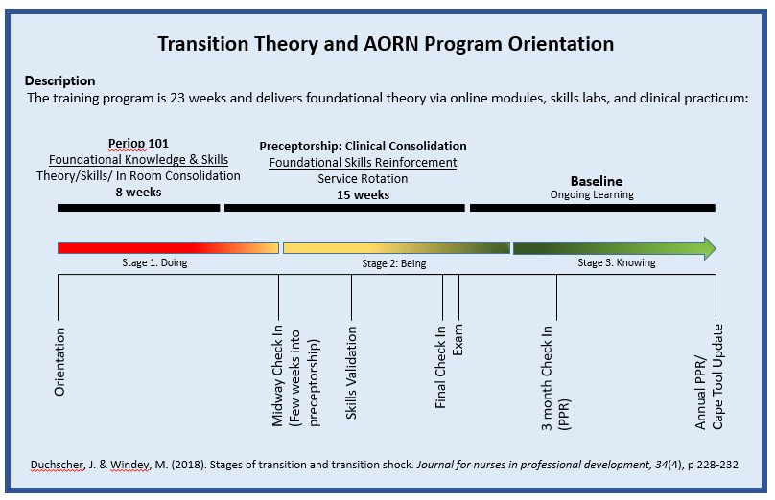


Themes identified by the BCCH OR’ educators from the responses and aligned the information with the Transition Framework by Duchscher & Windey (2018).
Consistent evaluation of perioperative nursing training program to maintain access to care
ds
PRESENTERS:
Fan, Karina; Franco, Maria; Harding, Stephanie; Patel, Pallavi
Creating a psychologically safe learning environment
Establishing a psychologically safe environment is an integral part of the program to mitigate transition shock for learners at BCCH OR.
All 11 nurses agreed the educators created a psychologically safe, supportive learning environment and were effective communicators. Learners found the environment a “safe space to ask questions and practice hands-on learning”.
THEMES
BACKGROUND
In 2016, an observed nursing shortage in the OR led to multiple challenges impacting children and families' access to surgical care across the province. The Association of Perioperative Registered Nurses (AORN) Periop 101 program, incorporating pediatric considerations, was launched in 2016 by the BC Children’s OR leadership team to train new nurses joining the department. Consistent evaluation of the program is in place to identify potential areas for improvement and enhance the experience of the learner, with a goal of stabilizing staffing to maintain access to care.
BEING
KNOWING
DOING
IMPLICATIONS FOR PRACTICE
Consistent preceptorship
Having a consistent preceptor as a resource to foster clinical development was identified as a suggestion for the clinical consolidation phase during preceptorship.
The transition theory supports having a consistent preceptor is valuable for ways to bend the transition shock and help maintain continuity in their learning, which is now incorporated into the program. (Duchscher & Windey, 2018)
111
METHODS
Data Collection
Data was collected using post-evaluation surveys and verbal and written feedback from nurses who have completed AORN Periop 101 training at BCCH OR from 2021 to 2023.
Data Analysis
A total of 19 surveys were sent, 11 surveys were completed. Verbal and written feedback were analyzed and grouped into major themes.
Check-ins
The need for continuous support was recognized during the preceptorship phase, and additional check-ins were structured and scheduled.
A midway check-in, a final check-in, and a 3-month post-check-in with the educators were incorporated to support nursing learners’ transition from one learning phase to the next.
      Figure 2: BCCH AORN Retention Rate
RESULTS
AORN Program Orientation and Transition Shock
Most responses expressed that the current teaching/learning styles being delivered are sufficient.
In order to create effective delivery for the program’s sustainability and maintain access to pediatric surgical care, teaching tools are consistently evaluated and updated by OR educators.
Updated Educational Strategies as a result of Continuous evaluation of the Program.
In conclusion, BC Children’s OR continues to sustain hiring with its ability to initiate, implement, and redesign the specialty training program. The Program has led many other adult and pediatric centers across Canada to contact the department for insights, teaching tools and lessons learned.
References
Duchscher, J. & Windey, M. (2018). Stages of transition and transition shock. Journal for nurses in professional development, 34(4), p 228-232
Lesson Plans
Clinical Observation
Validation Tools
Skills Checklist
Foundational Competency Tools
Fan, Karina RN, kfan@cw.bc.ca
Franco, Maria RN, CPN(C), maria.franco@cw.bc.ca,
Harding, Stephanie, RN, CPN(C), stephanie.harding@cw.bc.ca
Patel, Pallavi RN, MHLP, pallavi.patel@cw.bc.ca
Figure 1: Transition Theory and AORN Program Orientation
Notes:
Notes:
In Powerpoint, click View > Guides
Keep text within gutter guides.
Author list: Don’t split names onto two lines (e.g., “Jimmy [break] Smith”). If that happens, use a new line, unless you need the space. Bold the first names of anybody who’s presenting in person.
Intro/methods/result: Do not drop below font size 28, but if you have extra space, jack up the font size until the space is full.
Do not use color in the sidebars except in graphs/figures. It’ll pull attention from the center and slow interpretation for passersby.

