Slide 1
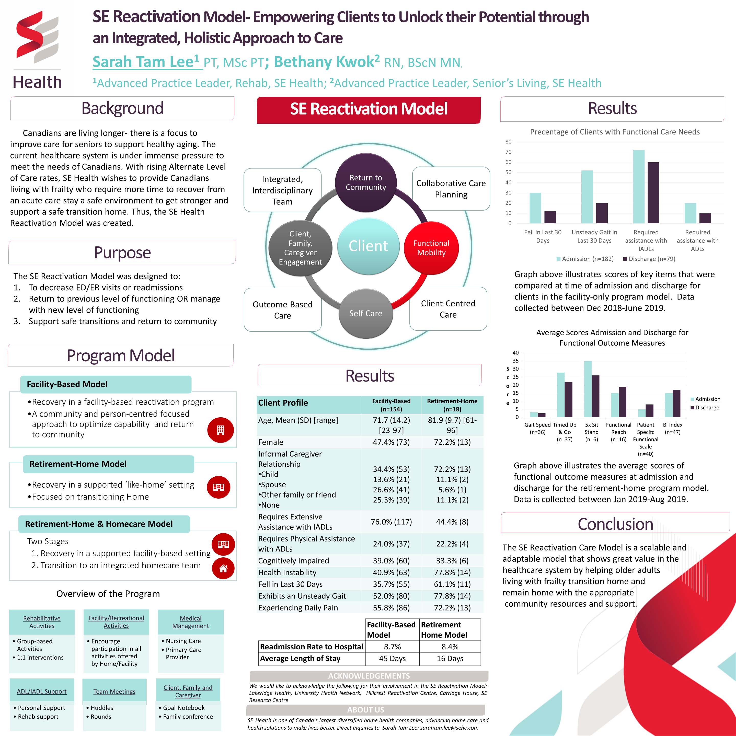


Slide 2
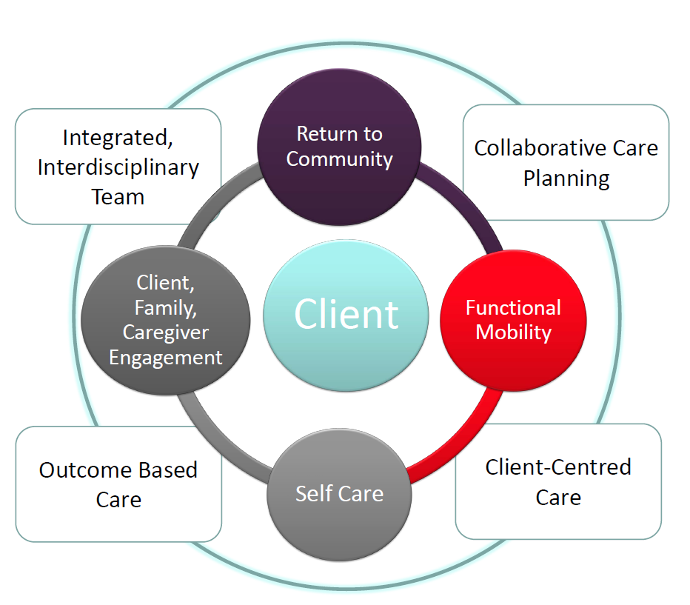
SE Reactivation Model of Care
Philosophical approach to care
GOALS: 1. Decrease ER Admission, Hospital Re-Admission rates
2. Return to Previous Level of Functioning
3. Support safe transitions and community reintegration
Notes:
The SE Reactivation Model of Care is a philosophical approach to care.
At the hear of the model is our clients
Series of interventions that facilitate optimal functioning and
increase independence as a result of focusing on the following critical areas of care:
Was created in response to providing program that allowed frail, older adults
who require more time to recover from an acute care stay a safe environment to get stronger and support a safe transition home.
SE Interdisciplinary Care Approach
Provision of Holistic, client-centred care by an interdisciplinary team
Collaborative care planning with the team and client/family/caregivers
Driven by outcome-based care with each client goal link to specific activities to achieve those goals
Focus on empowering self-care and improving functional mobility

Slide 3



Clinical Models
SE Health Reactivation Model is tailored to meet the needs of our partners
Facility-Based Model
Recovery in a facility-based reactivation program
Retirement-Home Model
Recovery in a controlled, supported ‘like-home’ setting
Retirement-Home & Homecare Model
Two Stages
A community and functional focused approach to optimize clients' capability and reintegration to community
Focused on transitioning Home
1. Recovery in a controlled, supported facility-based setting
2. Transition to an integrated homecare team

Slide 4
Overview of Program
Rehabilitative Activities
Group-based Activities
Facility/Recreational Activities
Encourage participation in all activities offered by the Home/Facility
Medical Management
Nursing Care
Primary Care Provider
1:1 interventions
ADL/IADL Support
Personal Support
Rehab enablement
Team Meetings
Client & Family/Caregiver Involvement
Goal Notebook
Meetings
Huddles
Rounds

Slide 5
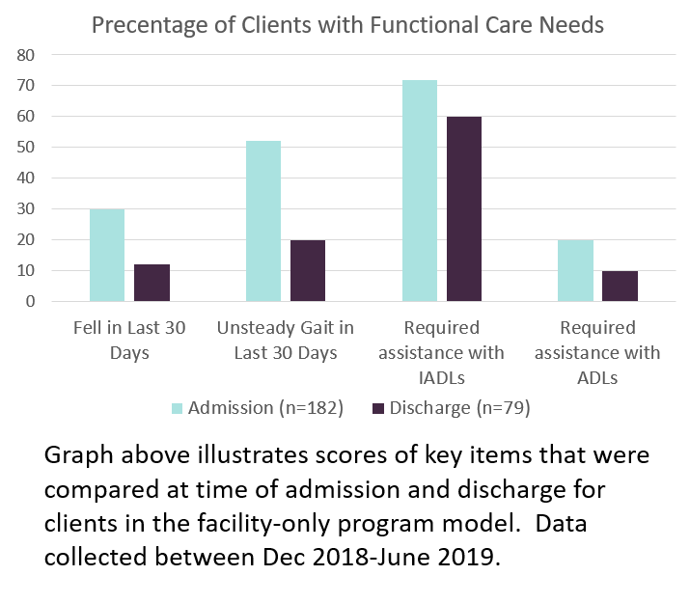
Facility Only Model- Results
Average Length of Stay: 45 Days
Readmission Rate to Hospital: 8.7%
Notes:
Data from Dec 2018 - June 2019

Slide 6
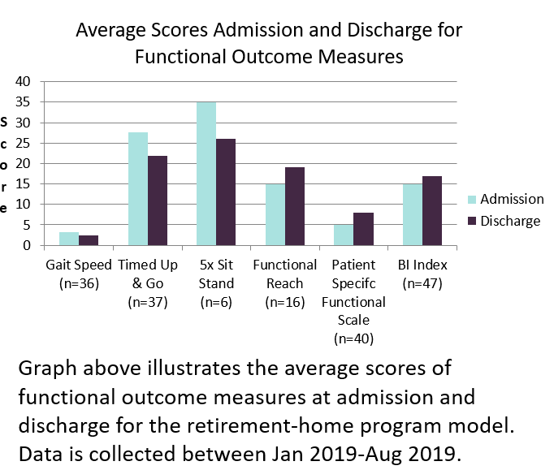
Retirement Home Model
Average Length of Stay 16 days
Readmission rate to the hospital: 8.4%

Slide 7

Patient/Client Feedback
this program is great and helped me a lot. I can’t wait to go home tomorrow to be with my puppy
SE Health Reactivation program helped me stand from chair, walk with the walker independently, go to the washroom safely, feed myself and learned a lot to keeping good spirits
who ever thought of this program was thinking right!
Satisfaction Survey
from the one of our programs:
100% of patients would refer this
service to family / friends
100% would participate again
There should be more programs like this in the province to help people in the hospital and I see great progress and I am happy about it
-
Great programs that helped me get through a difficult time and gave me strength and compassion

Slide 8

Thank You!
Thank you for your Interest in the SE Reactivation Model!
To learn more please connect with:
Sarah Tam Lee: sarahtamlee@sehc.com
Bethany Kwok: bethanykwok@sehc.com
www.sehc.com

